Slide 1
Digital Audio Compression
Seonkyo Ok

Slide 2

Goal
reduce size and
minimize quality loss

Slide 3
Contents
01
02
03
Theory
Methods
Example

Slide 4
Theory

Slide 5
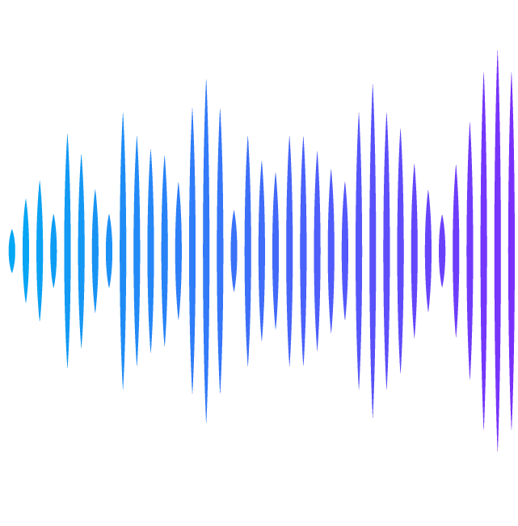
Audio
Signal

Slide 6
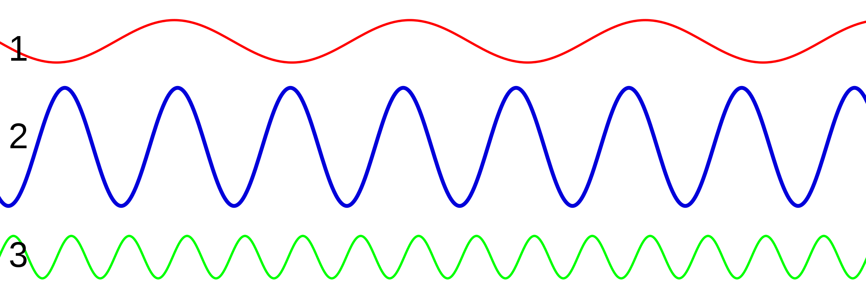
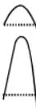
Characteristic of Sound Waves
Frequency
Amplitude
Timbre
determines
pitch
determines loudness
determines
characteristic

Slide 7

Pulse
Code
Modulation

Slide 8
Pulse Code Modulation
Sampling
Quantization
Encoding

Slide 9
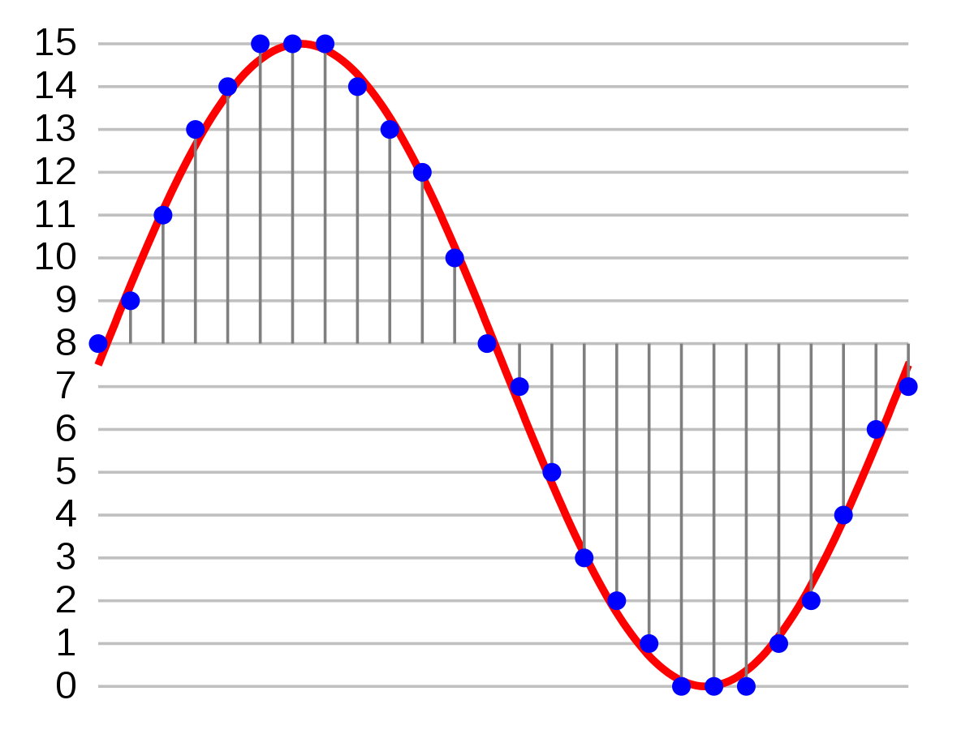
Sampling
“the reduction of a continuous-time signal to a discrete-time signal”
Wikipedia
Nyquist Theorem
To adequately reproduce a signal,
it should be periodically sampled at a rate
that is twice the highest frequency
of the original signal
lowering sampling rate leads to compression

Slide 10
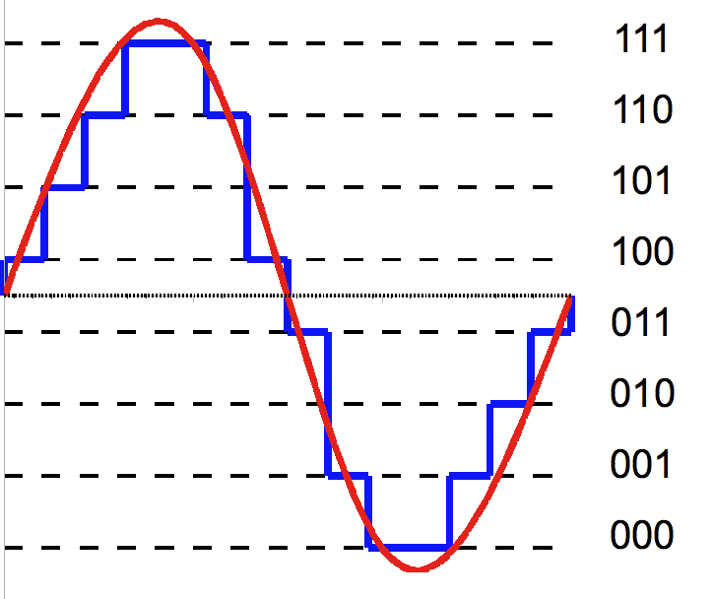
Quantization
“mapping input values from a large set to output values in a (countable) smaller set”
Wikipedia
Notice that quantization induces error,
despite the Nyquist sampling condition
Human’s perceptual ability is also considered
larger level distance leads to compression

Slide 11
Encoding
“assigns binary numbers to amplitude values”
Gray code
Single bit error results in
error of one level of amplitude
except when MSB is erroneous.

Slide 12
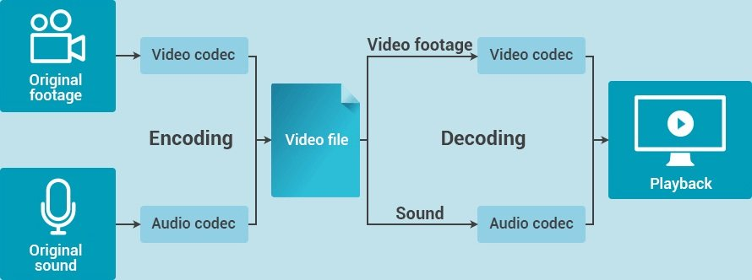
Codec
“a device or computer program which encodes or decodes a digital data stream or signal.
a portmanteau of coder-decoder”
Wikipedia
Notes:
princeton

Slide 13
ADPCM
MDCT
Perceptual Coding
Methods
perceptually lossless
adaptive
differential
PCM
modified discrete
cosine transform

Slide 14

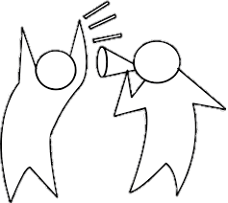
Perceptual Coding
perceptually lossless

Slide 15
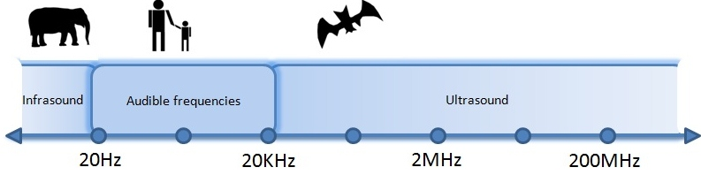
Perceptual Coding
Not all frequencies are needed
Humans are more sensitive to 2~4 kHz

Slide 16
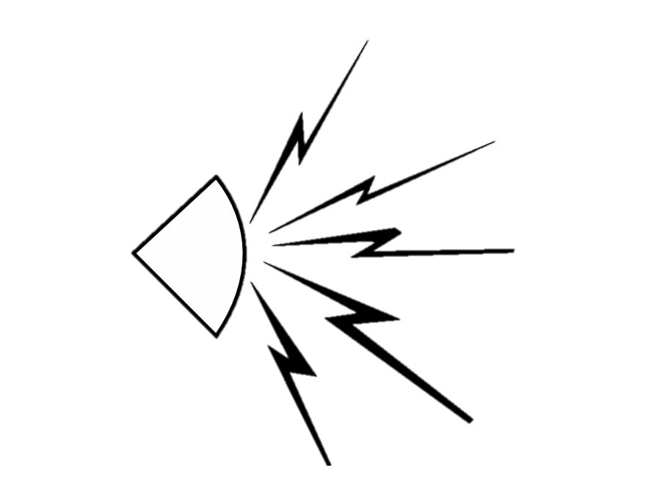
Perceptual Coding
loud sound can dominate
hearing threshold
time resolution
temporal masking
after hearing loud audio,
weak audio becomes inaudible

Slide 17
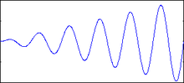
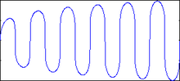
Companding
the loudest tolerable - 120dB
the weakest detectable - 0dB
human cannot perceive
1dB difference which is
12% in amplitude
nonlinear quantization save bits
“reduce the dynamic range of an audio signal
for better signal-to-noise ratio at lower bit depths”

Slide 18
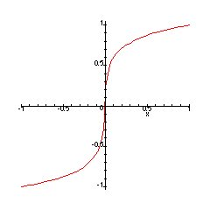
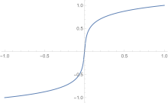
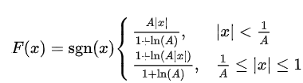
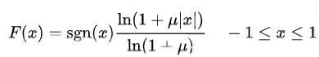
A-law / μ-law

Slide 19
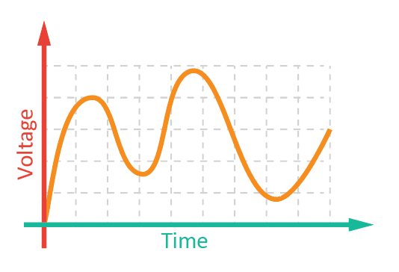
ADPCM

Slide 20
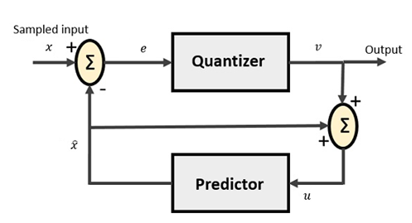
Differential PCM
can be compressed more if differences are later entropy coded

Slide 21
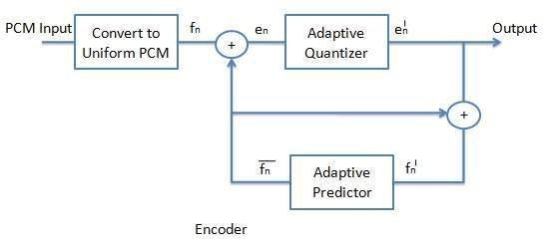
Adaptive DPCM
adaptive scale factor in quantization step
adaptive number of bits of difference signal

Slide 22
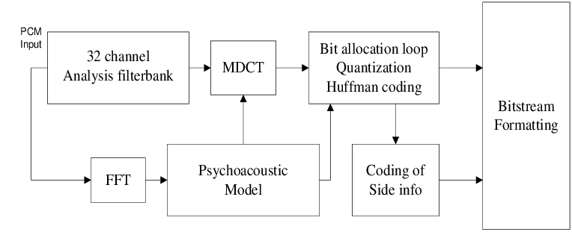
MP3
MPEG-1 Audio Layer-3

Slide 23
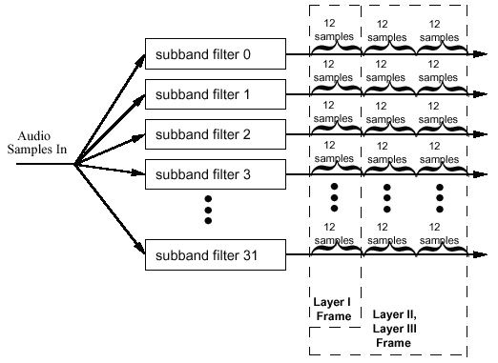
Subband Coding
assign more bits
to more sensitive region

Slide 24
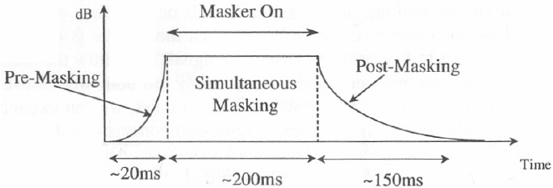
Temporal masking

Slide 25
MDCT

Slide 26
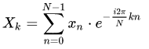
Fast Fourier Transform
DFT - O(n²)
“computes the discrete Fourier transform of a sequence”
Wikipedia
FFT – O(nlogn)
divide&conquer
converts a signal to a representation in the frequency domain
frequency domain analysis

Slide 27
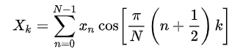
Discrete Cosine Transform
FCT – O(nlogn)
use only real part
less number of terms are needed to represent a signal
better for compression

Slide 28
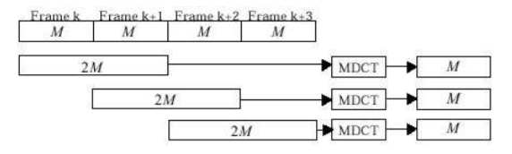
Modified DCT
two input blocks at a time
avoid artifacts at block boundaries
used widely in audio compression

Slide 29
MP3
MPEG-1 Audio Layer-3

Slide 30
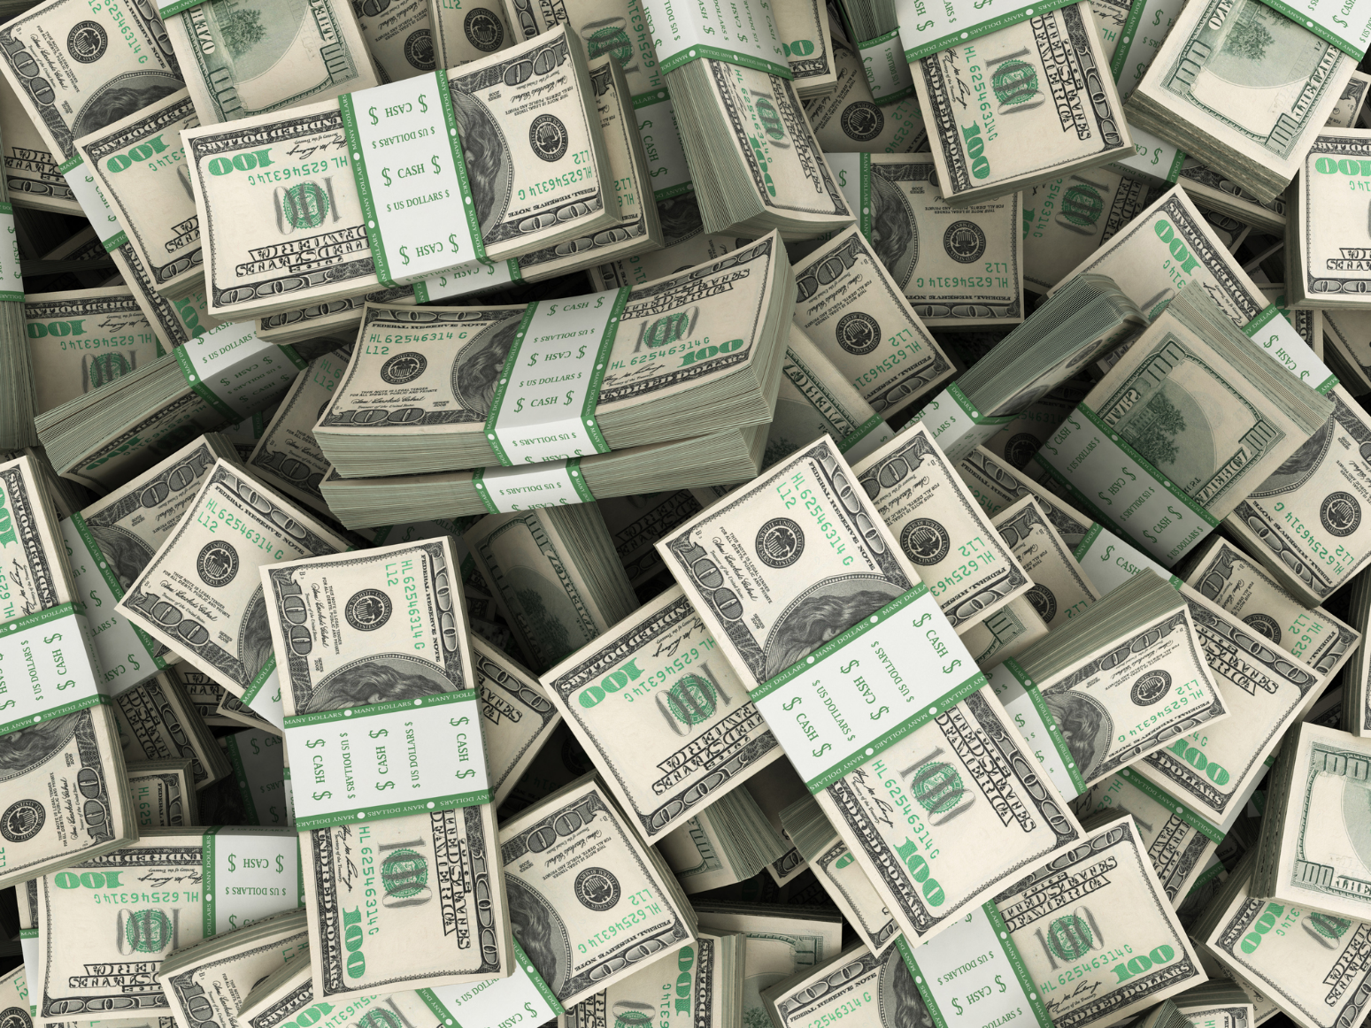
Total loyalty fee for MP3 in ’06
100 million euros

Slide 31
References
wiki.gurubee.net/
blog.naver.com/vasurada0/
namu.wiki/
wiki.hydrogenaud.io/
en.wikipedia.org/
www.ktword.co.kr/
www.sciencedirect.com/
microscopy.berkeley.edu/
mintnlatte.tistory.com/
watershipdown42.weebly.com/
de.slideshare.net/deepikakamboj946/
web.sonoma.edu/esee/courses/ee442/

Slide 32
References
kocw.or.kr/
movavi.io/
www.telecomabc.com/
ece.utexas.edu/
www.dspguide.com/
evive.cc/
ic.ac.uk/
tutorialspoint.com/
www.handelsblatt.com/
cs.stanford.edu/
researchgate.net/
washingtonpost.com/
dsp.stackexchange.com/
www.mp3-tech.org/

Slide 33
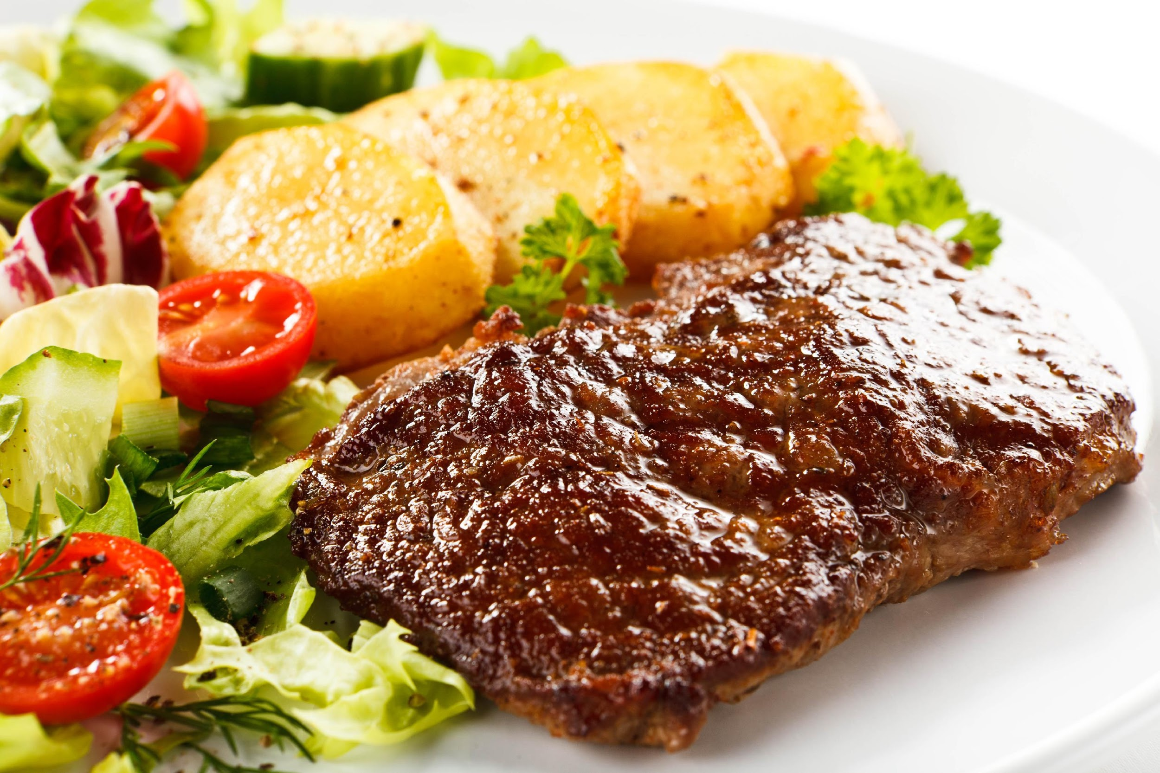
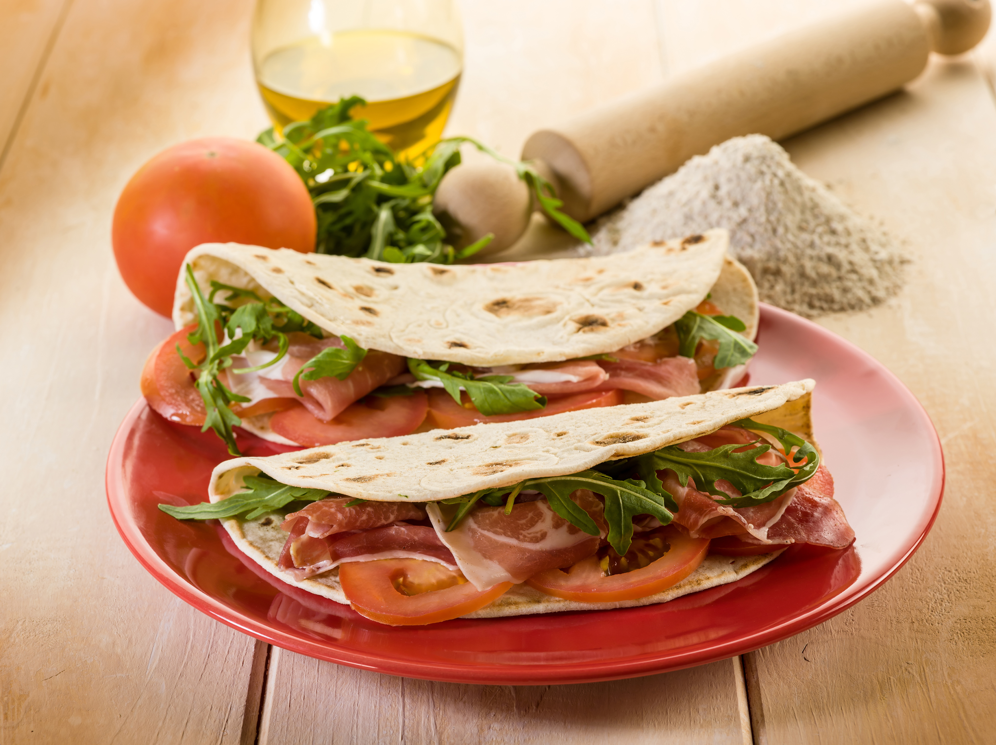
THANKS

